Slide 1

What’s New in FuturaGIS 3.3 Mapping
Sherri Schreiner
&
Scott Thomas

Slide 2
FuturaGIS v3.3 compatible with ArcGIS 10.4
Added new validation checks for coincident vertices and null geometry as well as requiring a reason when exempting errors
Flow will automatically be set before running export and following validations
Phase & Phasing update tool supports barriers
Network Attributes can now be configured to display all feature classes

Slide 3
FuturaGIS v3.3 is compatible with ArcGIS 10.4!!!

Slide 4

User Interface:
Updated Icons For Futura GIS
Set Flow:
Futura Set Flow is now programmatically set to run prior to an export task and validations: Electrical Loops, Disconnected Elements, and Phase Validation.
Phase & Phasing Update Tool:
Enhancements were made to support barriers while updating phasecode and phasing for primary conductors.

Slide 5
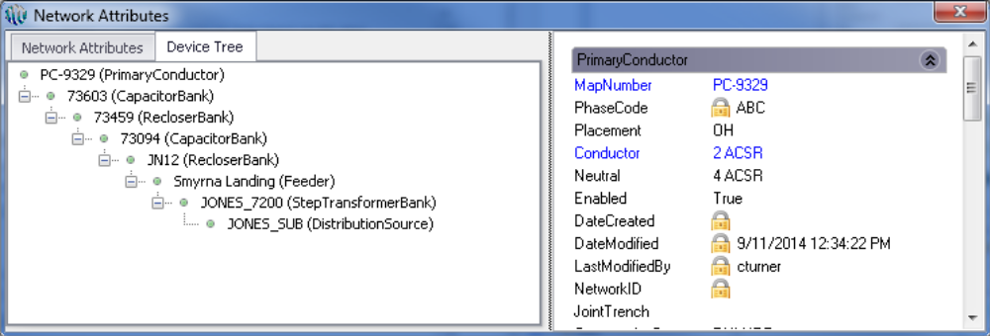
Network Attribute:
The Network Attributes device tree will display any feature classe(s) that are configured in “Mapping Settings --> Electric User Defined Settings --> Network Attributes Display Classes”.

Slide 6

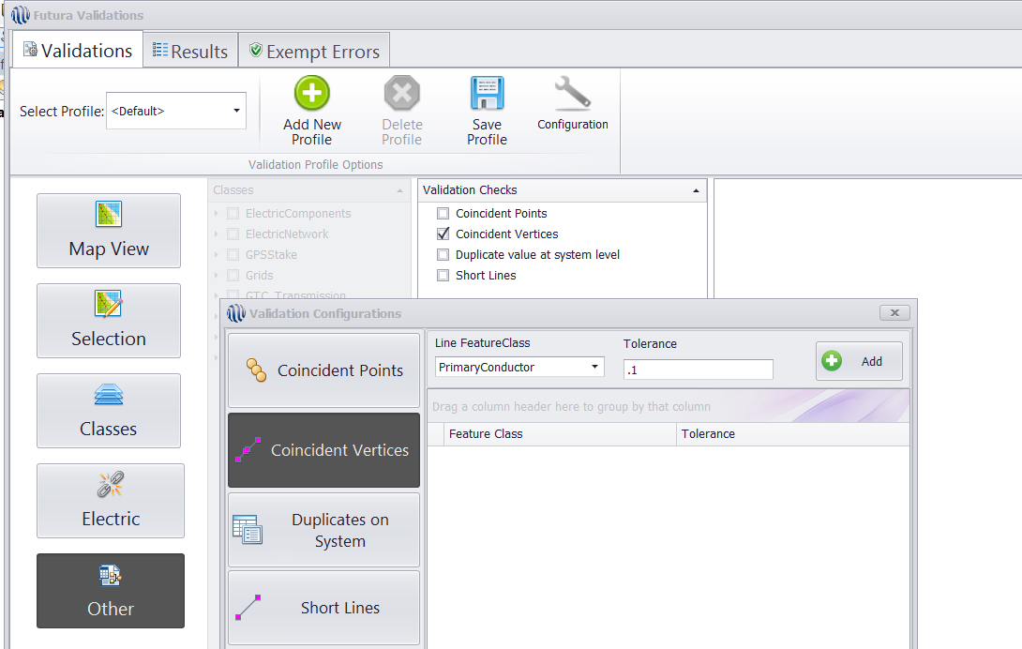
Validation Tool:
Added a new validation to check for coincident vertices in line feature classes. This validation will find all line features with coincident vertices. This new validation appears on the “Other” tab and the search tolerance index is configurable.

Slide 7
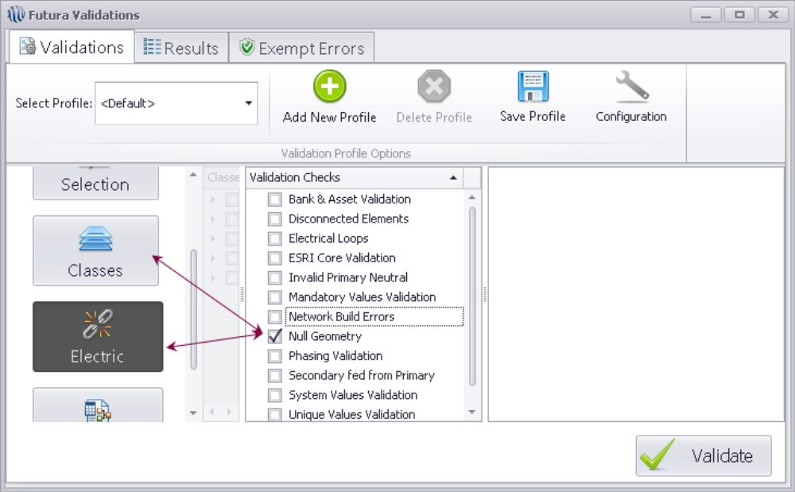
Validation Tool: Continued
Added a new validation that will check for ‘Null Geometry’ and ‘Network Build Errors’. In the 'Electric' category, these tools will check for all network feature classes except NetJunctions.

Slide 8
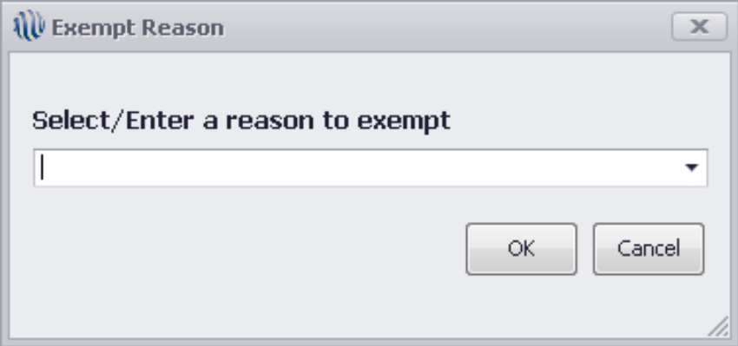
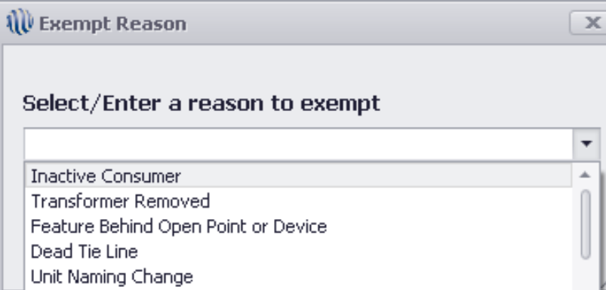
Validation Tool: Continued
A comments field has been added to the validation “Results” tab. This field will store reasons provided for exempting a record(s).
User can select multiple line items on the result tab and mass exempt with a single type of comment.
The Exempt Reasons can be customized through a domain.

Slide 9
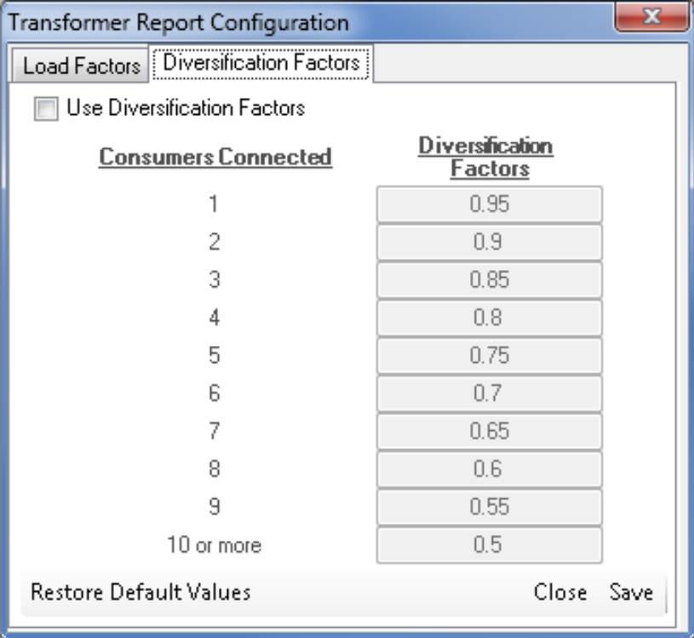
Futura Report:
An option was made available to choose if the Transformer Load Calculation should use a Diversification Factor or not. A check box was provided on ‘Diversification Factors’ setting tab and a button to ‘Save’ the setting to a ’config’ file.

Slide 10
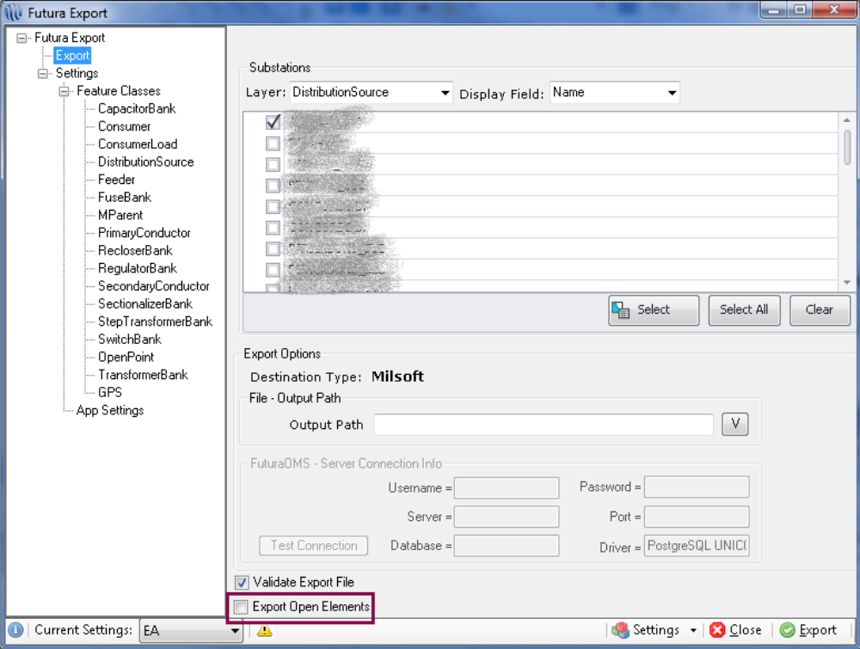
Futura Export:
The 'Export Open Elements' is a global option that only exports features which are connected but un-energized

Slide 11
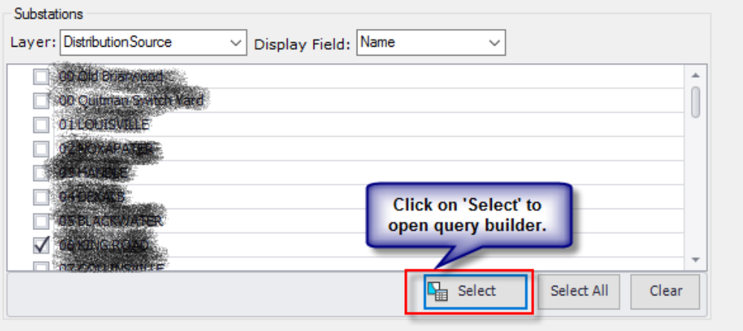
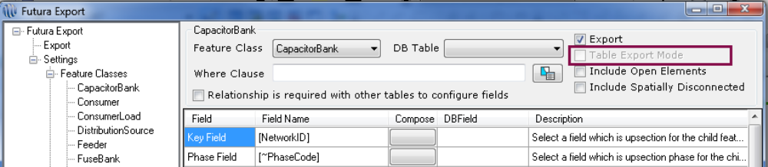
Futura Export: Continued
Updated the default settings for Milsoft export.
Provided filter option which allows users to filter substations and select based on one or more field values ex: select all distribution substations.
The 'Table Export Mode' option in the Futura Export tool now allows user to export non-network feature classes, tables and physically disconnected features (features that are part of the network but not connected)

Slide 12
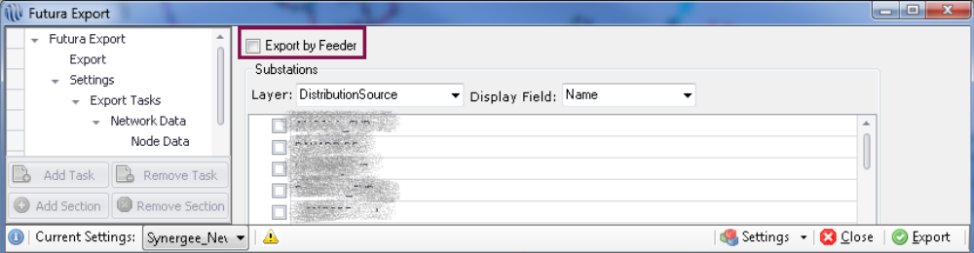
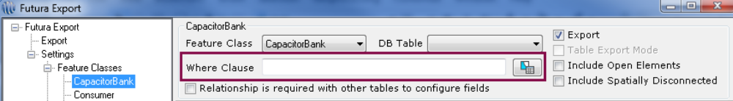
Futura Export: Continued
Provided a selection option at the top of the window to ‘Export by Feeder’ for Cyme & Synergee engineering analysis software applications.
Provided the ability to add a where clause option for each feature class when performing an export to Milsoft engineering analysis software

Slide 13
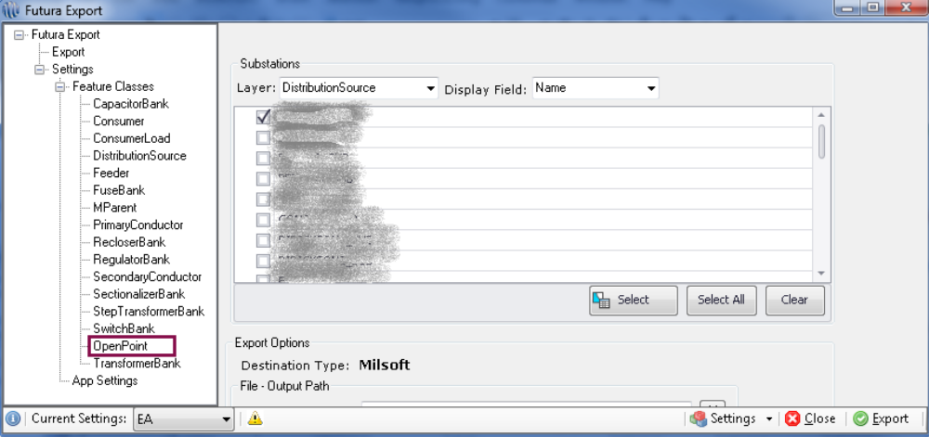
Futura Export: Continued
Provided the ability to include open points, when exporting a model to OMS & Milsoft.

Slide 14

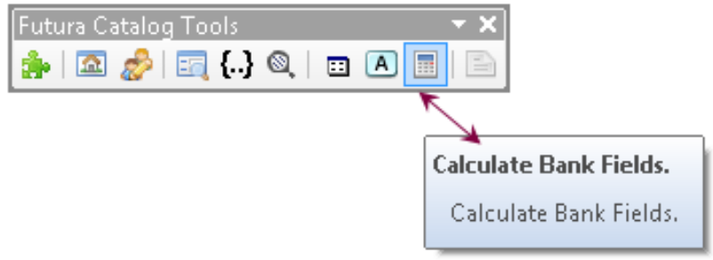
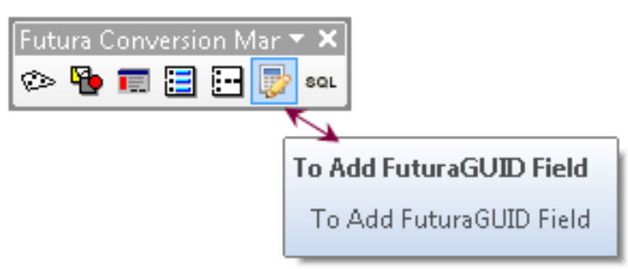
Futura Catalog Tools:
The Calculate Bank Fields tool, a Futura conversion tool on the Futura Catalog Tools toolbar in ArcCatalog, has been greatly enhanced.
A pop up message has been added when a user clicks the Calculate Bank Fields tool in the Futura Catalog toolbar. A message that says "This process may take a very long time. Are you sure you want to execute this tool?" with a “Yes” and “No” action item for user to choose from.
A pop up message has been added when a user clicks the Add FuturaGUID tool in the Futura Catalog toolbar. A message that says "This process may take a very long time. Are you sure you want to execute this tool?" with a “Yes” and “No” action item for user to choose from.

Slide 15
Questions??
Please contact
Support@futuragis.com
Would you like to be upgraded?
Contact Upgrades@futuragis.com to get on the schedule

